Slide 1
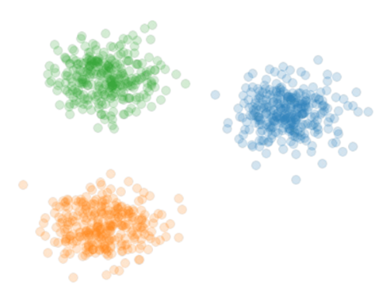
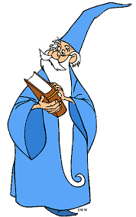

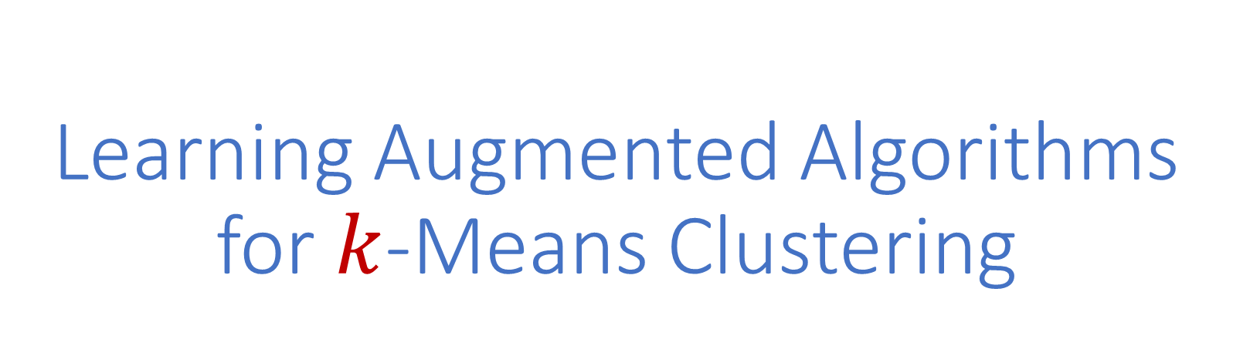
Learning Augmented Algorithms for $k$-Means Clustering
Samson Zhou
Notes:
Talk slower, balanced syllables

Slide 2
Learning Augmented Algorithms for $k$-Means Clustering
Jon Ergun
Zhili Feng
Sandeep Silwal
David P. Woodruff
Samson Zhou
Thy Nguyen
Anamay Chatuvedi
Huy Lê Nguyên
˜
[NCN23]
[EFSWZ22]
Notes:
Talk slower, balanced syllables

Slide 3

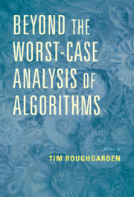
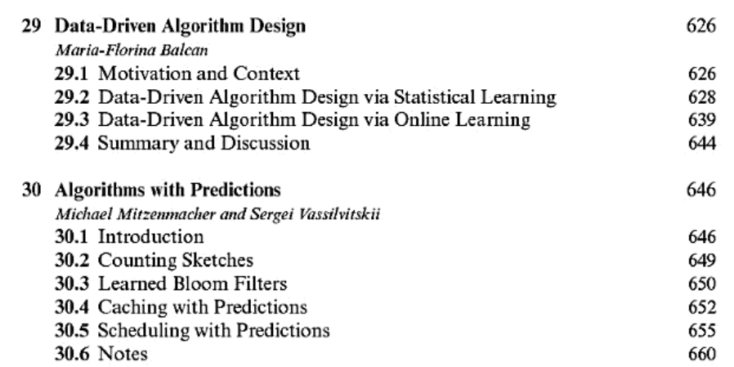

Slide 4
Learning-Augmented Algorithms
For a certain task and input, algorithm is given advice
Advice could be “good”, advice could be “bad”
Goal: “Good” performance if the advice is good, “normal” performance if the advice is bad

Slide 5
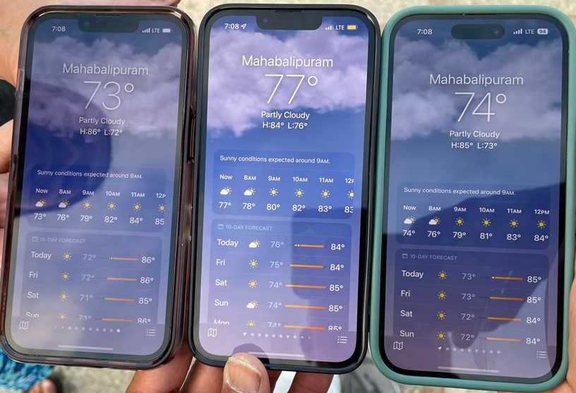

Slide 6
Learning-Augmented Algorithms
Better data structures: Bloom filters with lower false positive rates [Mitzenmacher18], Binary search [LinLuoWoodruff22]
Better space-accuracy tradeoff for streaming algorithms: Frequency estimation, e.g., CountMin, CountSketch [HsuIndykKatabiVakilian19], moment estimation, distinct elements [JiangLinRuanWoodruff20], triangle counting [ChenEdenIndykLinNarayananRubinfeldSilwalWagnerWoodruffZhang22]
Better size-accuracy tradeoff for sketching: Low-rank approximation [IndykVakilianYuan19]
Notes:
[Mitzenmacher18], [HsuIndykKatabiVakilian19], [JiangLiRuanWoodruff20], [ChenEdenIndykLinNarayananRubinfeldWagnerWoodruffZhang22], [IndykVakilianYuan19], [ChenSilwalVakilianZhang22], [DaviesMoseleyVassilivskiWang23], [DinitzImLavastidaMoseleyVassilvitskii21], [EdenIndykNarayananRubinfeldSilwalWanger21], [BamasMaggioriSvensson20], [LattanziLavastidaMoseleyVassilvitskii20], [ScullyGrosofMitzenmacher22] [KhodakAminDickVassilvitskii23]

Slide 7
Learning-Augmented Algorithms
Warm-start to search algorithms: Max-flow [ChenSilwalVakilianZhang22], [DaviesMoseleyVassilvitskiiWang23], matchings [DinitzImLavastidaMoseleyVassilvitskii21]
Better accuracy-sample complexity tradeoff: Support size estimation [EdenIndykNarayananRubinfeldSilwalWagner21]
Better online algorithms: Set cover [BamasMaggioriSvensson20], [GrigorescuLinSilwalSongZhou23], Scheduling [LattanziLavastidaMoseleyVassilvitskii20], [ScullyGrosofMitzenmacher22]
Better privacy-utility tradeoffs for DP: Quantile estimation [KhodakAminDickVassilvitskii23]
Beating NP-hardness?
Notes:
[Mitzenmacher18], [HsuIndykKatabiVakilian19], [JiangLiRuanWoodruff20], [ChenEdenIndykLinNarayananRubinfeldWagnerWoodruffZhang22], [IndykVakilianYuan19], [ChenSilwalVakilianZhang22], [DaviesMoseleyVassilivskiWang23], [DinitzImLavastidaMoseleyVassilvitskii21], [EdenIndykNarayananRubinfeldSilwalWanger21], [BamasMaggioriSvensson20], [LattanziLavastidaMoseleyVassilvitskii20], [ScullyGrosofMitzenmacher22] [KhodakAminDickVassilvitskii23]

Slide 8
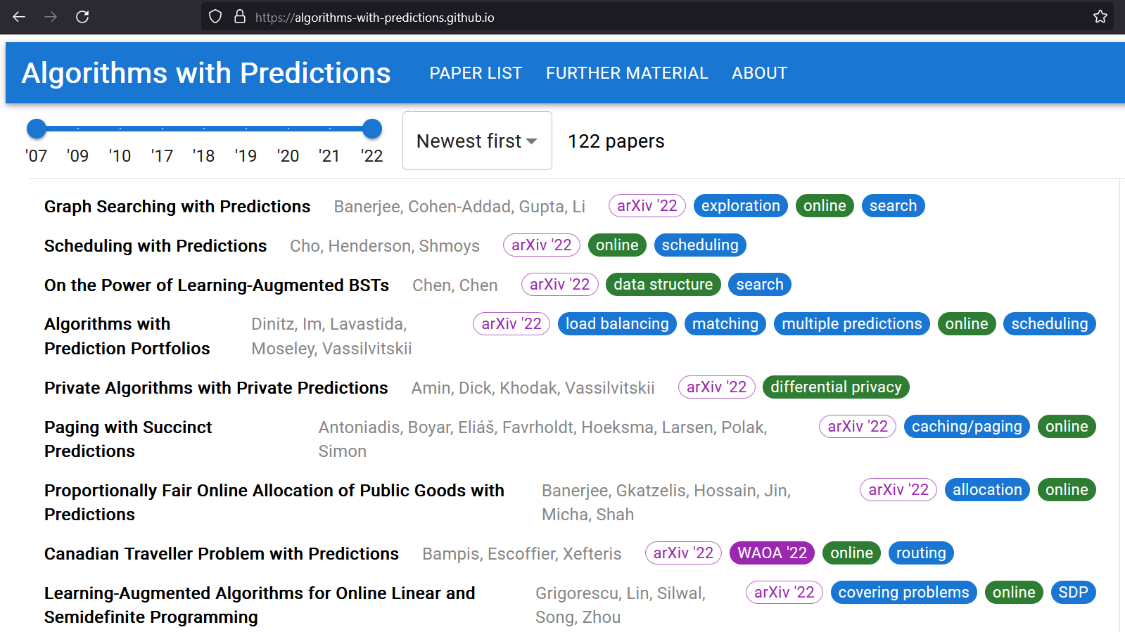

Slide 9
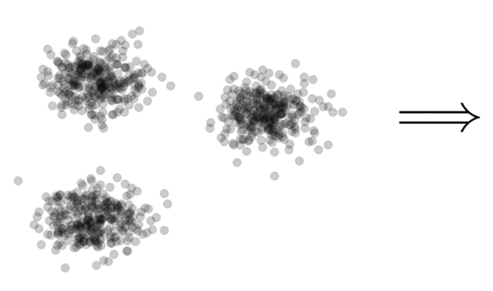

Clustering
Goal: Given input dataset $X$, partition $X$ so that “similar” points are in the same cluster and “different” points are in different clusters

Slide 10
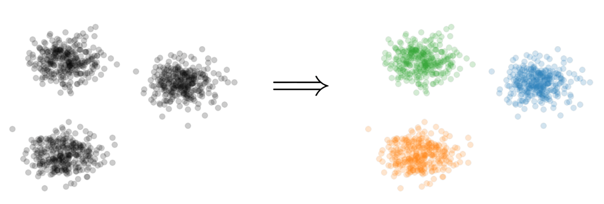
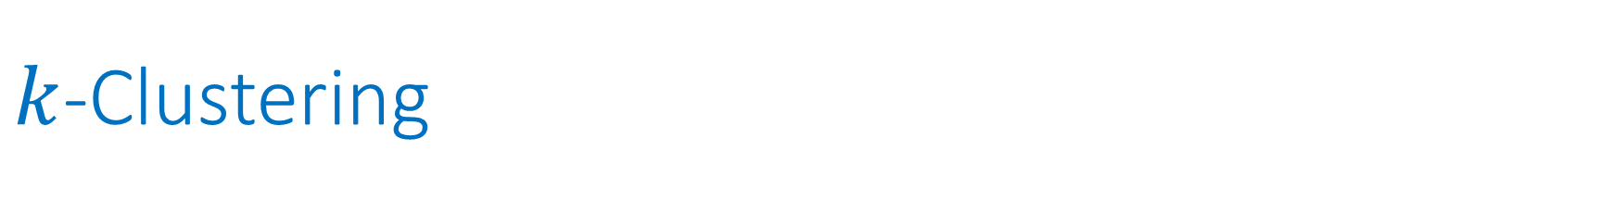

$k$-Clustering
Goal: Given input dataset $X$, partition $X$ so that “similar” points are in the same cluster and “different” points are in different clusters
There can be at most $k$ different clusters
$$k=3$$

Slide 11
$k$-Clustering
Question: How do we measure the “quality” of each clustering?
$$k=3$$

Slide 12
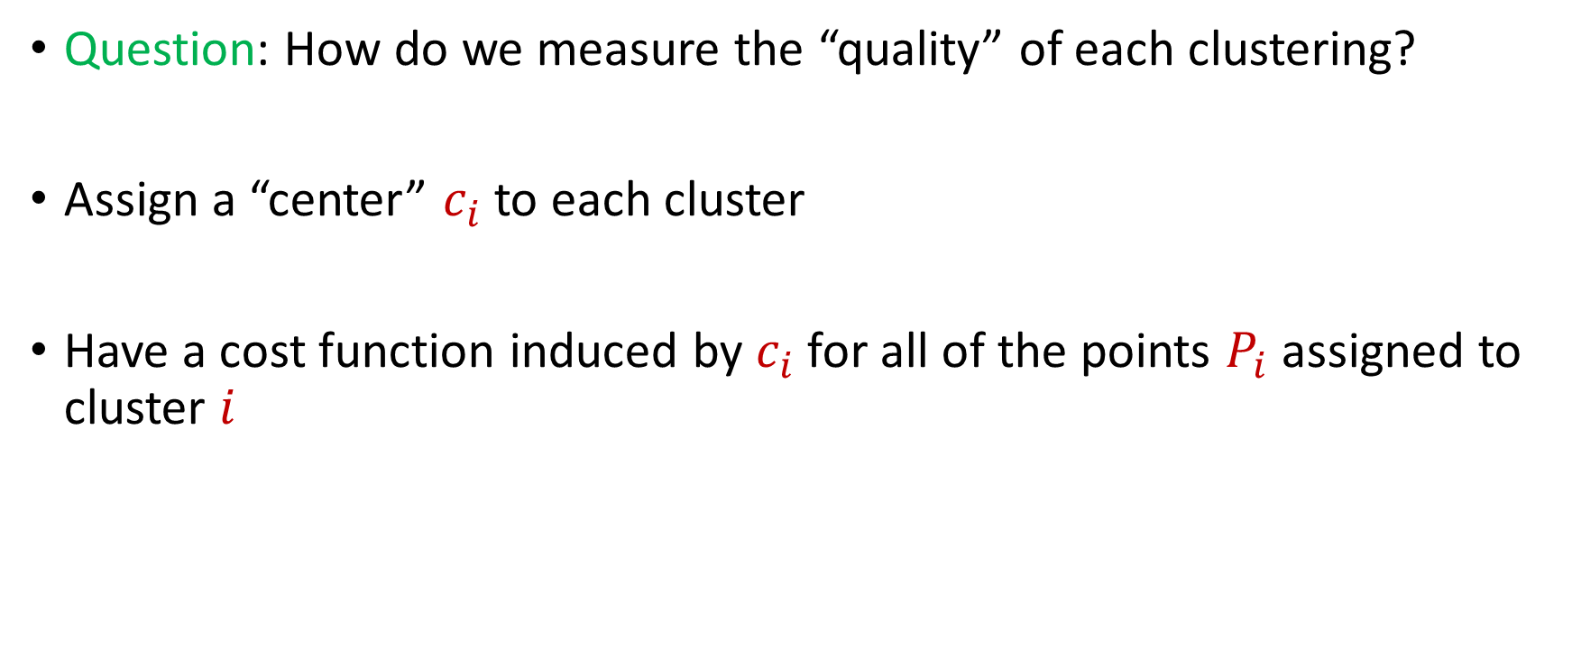
$k$-Clustering
Question: How do we measure the “quality” of each clustering?
Assign a “center” $c_{i}$ to each cluster
Have a cost function induced by $c_{i}$ for all of the points $P_{i}$ assigned to cluster $i$

Slide 13
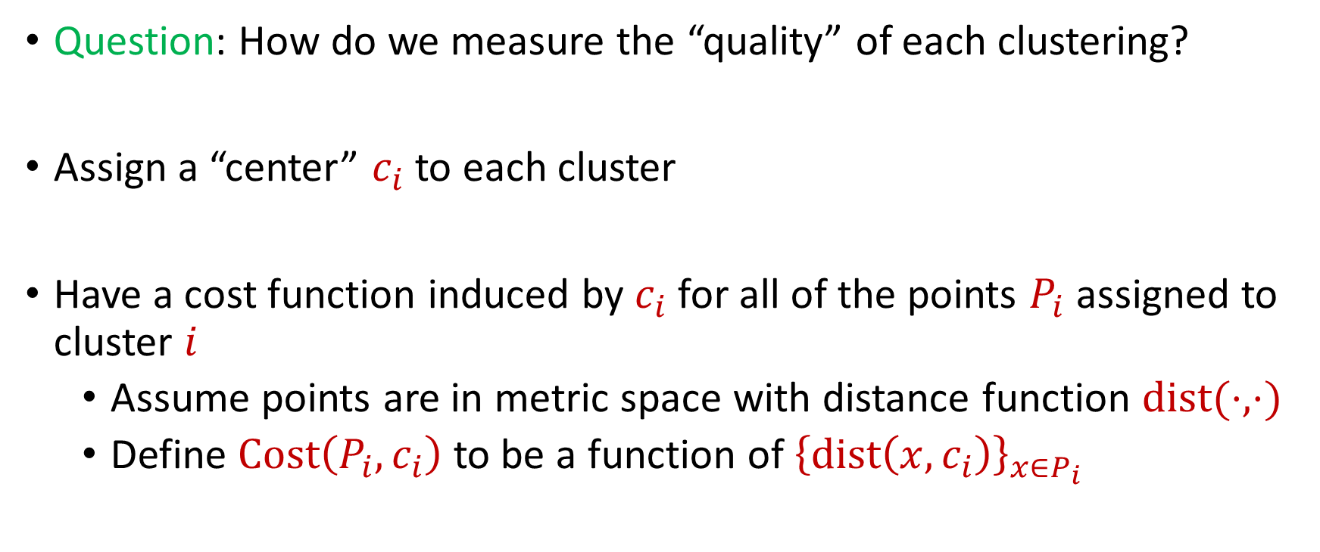
$k$-Clustering
Question: How do we measure the “quality” of each clustering?
Assign a “center” $c_{i}$ to each cluster
Have a cost function induced by $c_{i}$ for all of the points $P_{i}$ assigned to cluster $i$
Assume points are in metric space with distance function $dist(⋅,⋅)$
Define $Cost\left(P_{i},c_{i}\right)$ to be a function of ${\left\{dist\left(x,c_{i}\right)\right\}}_{x∈P_{i}}$

Slide 14
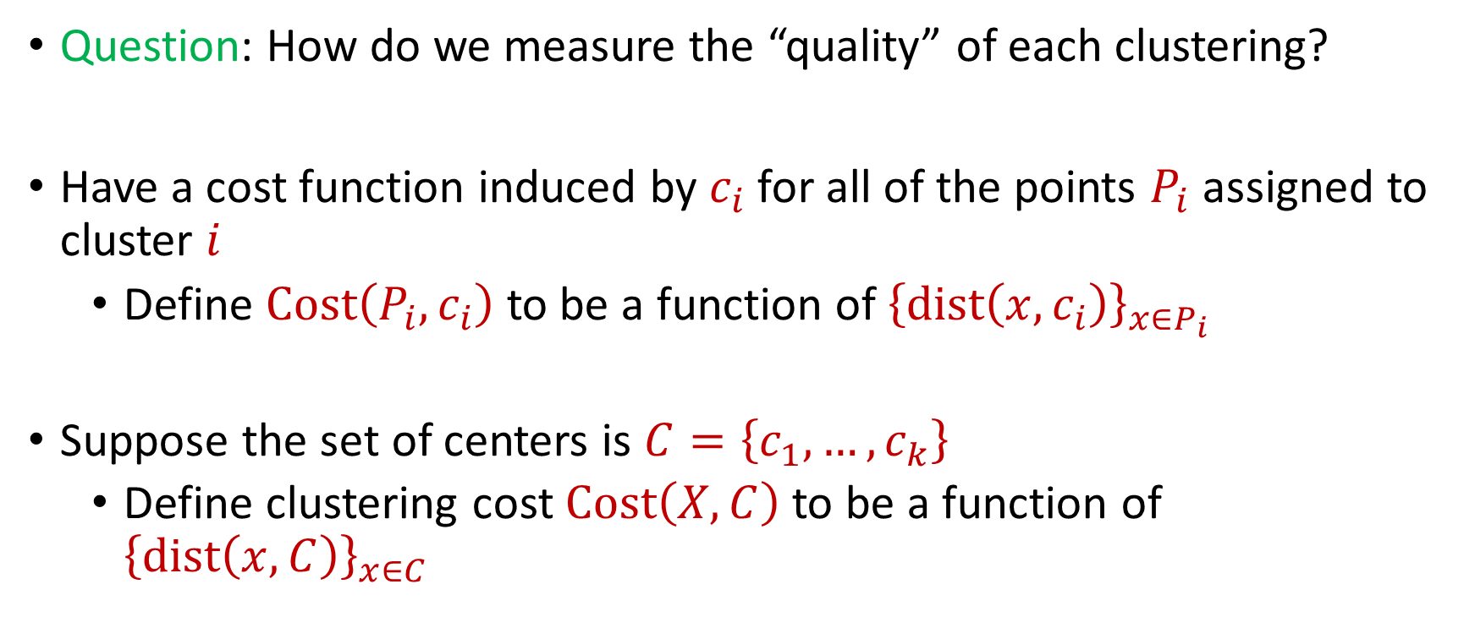
$k$-Clustering
Question: How do we measure the “quality” of each clustering?
Have a cost function induced by $c_{i}$ for all of the points $P_{i}$ assigned to cluster $i$
Define $Cost\left(P_{i},c_{i}\right)$ to be a function of ${\left\{dist\left(x,c_{i}\right)\right\}}_{x∈P_{i}}$
Suppose the set of centers is $C=\left\{c_{1},…, c_{k}\right\}$
Define clustering cost $Cost\left(X,C\right)$ to be a function of ${\left\{dist\left(x,C\right)\right\}}_{x∈C}$

Slide 15

$k$-Clustering
Define clustering cost $Cost\left(X,C\right)$ to be a function of ${\left\{dist\left(x,C\right)\right\}}_{x∈C}$

Slide 16
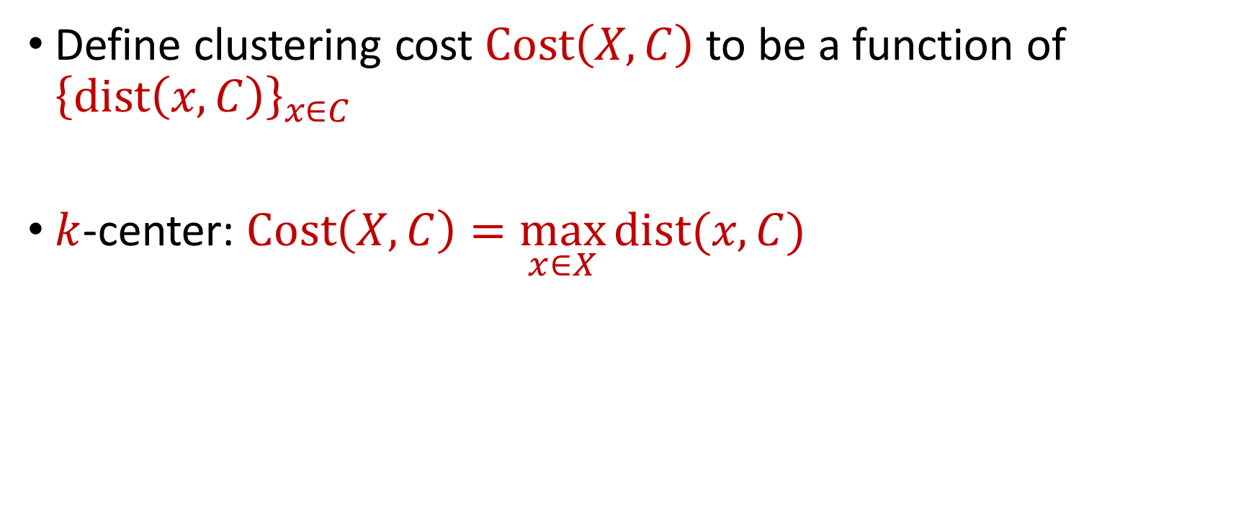
$k$-Clustering
Define clustering cost $Cost\left(X,C\right)$ to be a function of ${\left\{dist\left(x,C\right)\right\}}_{x∈C}$
$k$-center: $Cost\left(X,C\right)=\max_{x∈X}{dist(x,C)}$

Slide 17
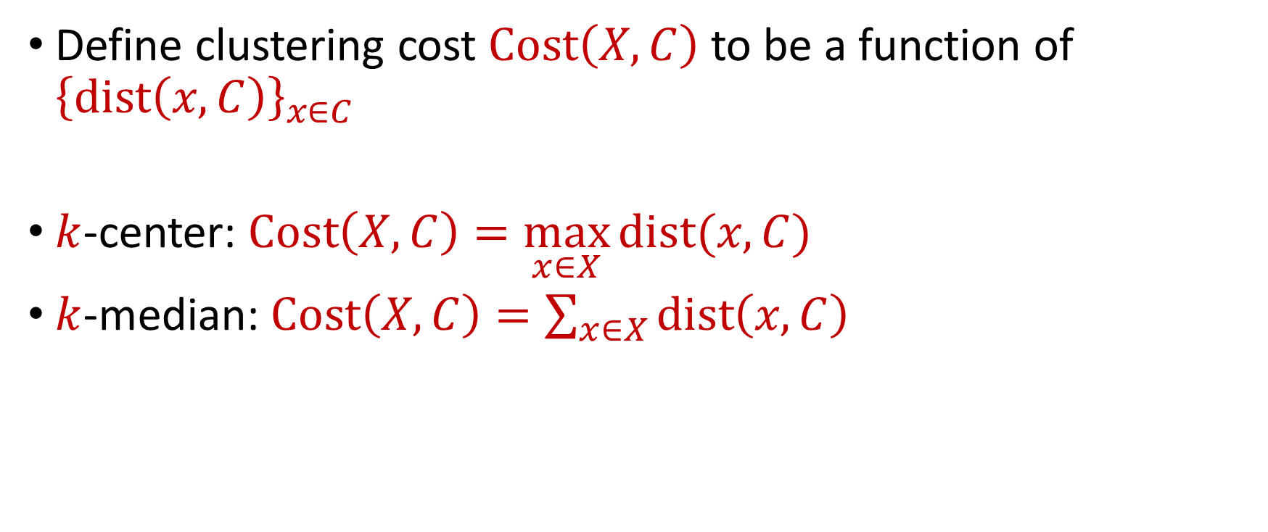
$k$-Clustering
Define clustering cost $Cost\left(X,C\right)$ to be a function of ${\left\{dist\left(x,C\right)\right\}}_{x∈C}$
$k$-center: $Cost\left(X,C\right)=\max_{x∈X}{dist(x,C)}$
$k$-median: $Cost\left(X,C\right)=\sum_{x∈X}{dist\left(x,C\right)}$

Slide 18

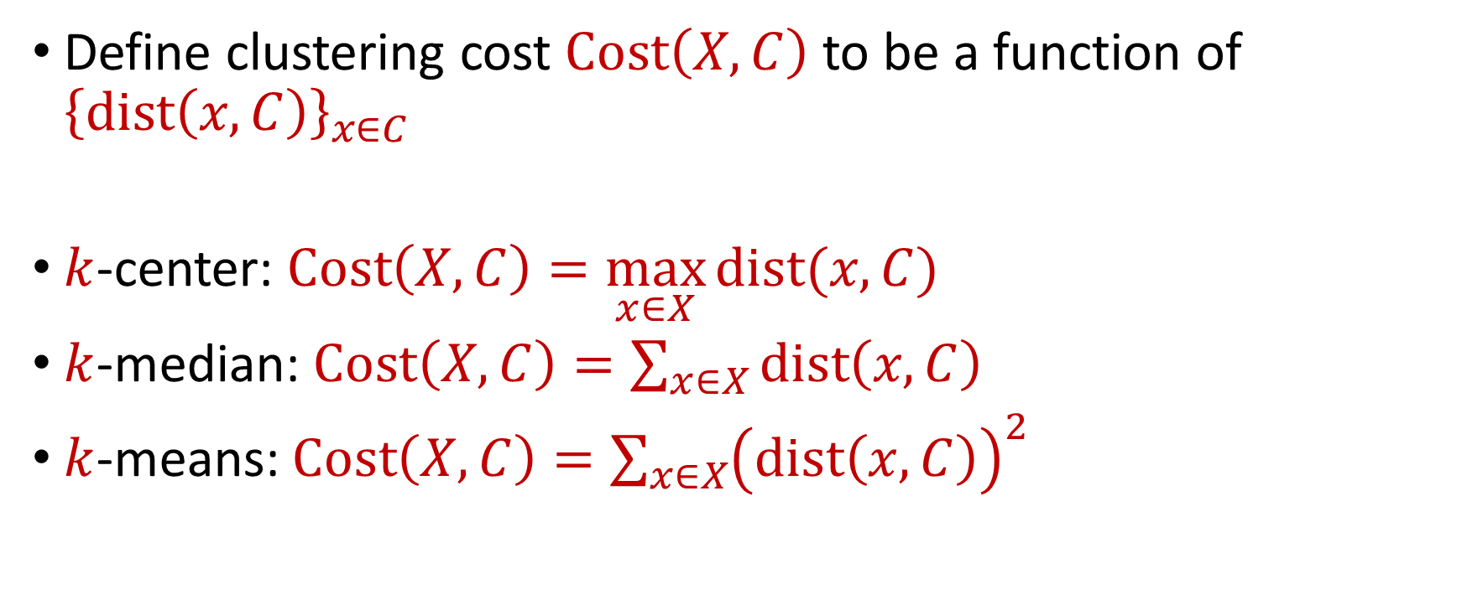






$k$-Clustering
Define clustering cost $Cost\left(X,C\right)$ to be a function of ${\left\{dist\left(x,C\right)\right\}}_{x∈C}$
$k$-center: $Cost\left(X,C\right)=\max_{x∈X}{dist(x,C)}$
$k$-median: $Cost\left(X,C\right)=\sum_{x∈X}{dist\left(x,C\right)}$
$k$-means: $Cost\left(X,C\right)=\sum_{x∈X}{{\left(dist\left(x,C\right)\right)}^{2}}$
$${\left(⋅\right)}^{2}$$
$${\left(⋅\right)}^{2}$$
$${\left(⋅\right)}^{2}$$
$${\left(⋅\right)}^{2}$$
$${\left(⋅\right)}^{2}$$
$${\left(⋅\right)}^{2}$$
$${\left(⋅\right)}^{2}$$

Slide 19

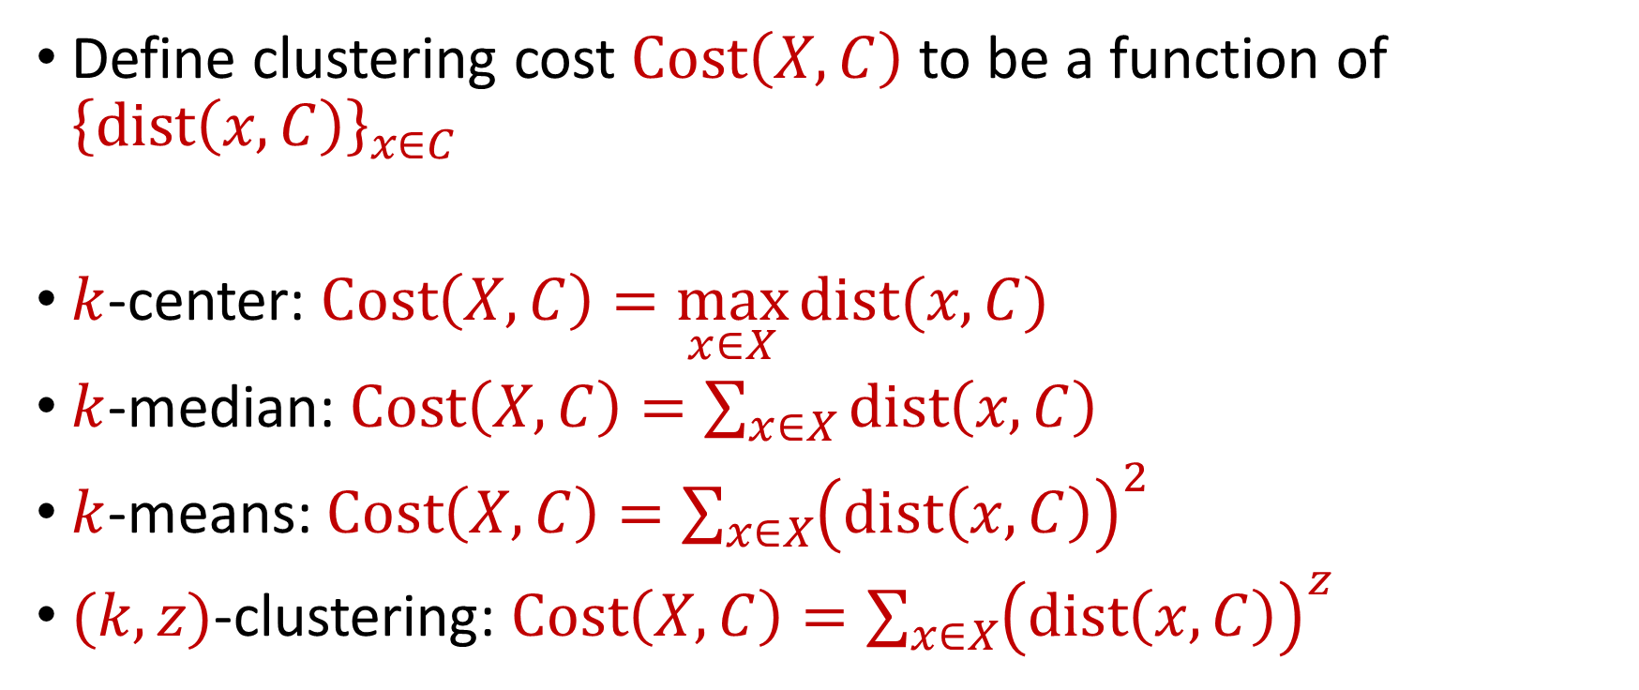






$k$-Clustering
Define clustering cost $Cost\left(X,C\right)$ to be a function of ${\left\{dist\left(x,C\right)\right\}}_{x∈C}$
$k$-center: $Cost\left(X,C\right)=\max_{x∈X}{dist(x,C)}$
$k$-median: $Cost\left(X,C\right)=\sum_{x∈X}{dist\left(x,C\right)}$
$k$-means: $Cost\left(X,C\right)=\sum_{x∈X}{{\left(dist\left(x,C\right)\right)}^{2}}$
$(k,z)$-clustering: $Cost\left(X,C\right)=\sum_{x∈X}{{\left(dist\left(x,C\right)\right)}^{z}}$
$${\left(⋅\right)}^{z}$$
$${\left(⋅\right)}^{z}$$
$${\left(⋅\right)}^{z}$$
$${\left(⋅\right)}^{z}$$
$${\left(⋅\right)}^{z}$$
$${\left(⋅\right)}^{z}$$
$${\left(⋅\right)}^{z}$$

Slide 20
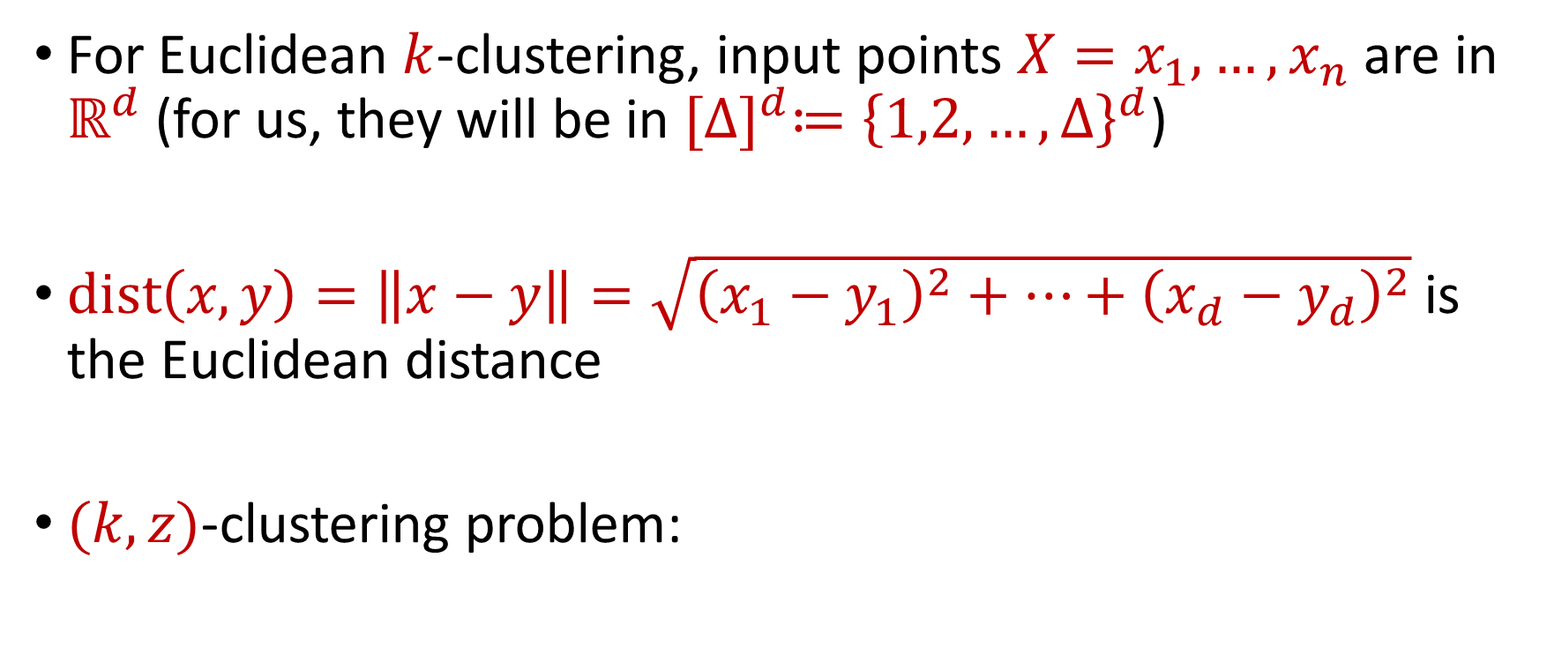


Euclidean $k$-Clustering
For Euclidean $k$-clustering, input points $X=x_{1},…,x_{n}$ are in $ℝ^{d}$ (for us, they will be in ${[Δ]}^{d}≔{\left\{1,2,…,Δ\right\}}^{d}$)
$dist\left(x,y\right)=\left\|x−y\right\|=\sqrt{{\left(x_{1}−y_{1}\right)}^{2}+…+{\left(x_{d}−y_{d}\right)}^{2}}$ is the Euclidean distance
$(k,z)$-clustering problem:
$$\min_{C:\left|C\right|≤k} Cost\left(X,C\right)=\min_{C:\left|C\right|≤k}{Σ_{x∈X}\left(dist\left(x,C\right)\right)}^{z}$$

Slide 21
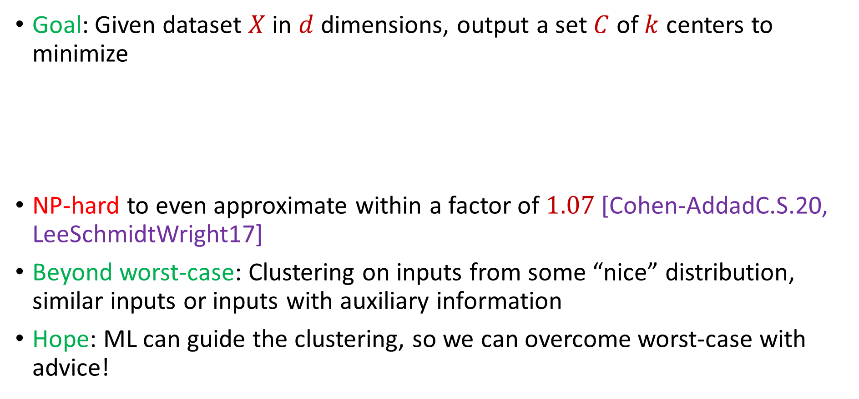

Learning-Augmented Clustering
Goal: Given dataset $X$ in $d$ dimensions, output a set $C$ of $k$ centers to minimize
NP-hard to even approximate within a factor of $1.07$ [Cohen-AddadC.S.20, LeeSchmidtWright17]
Beyond worst-case: Clustering on inputs from some “nice” distribution, similar inputs or inputs with auxiliary information
Hope: ML can guide the clustering, so we can overcome worst-case with advice!
$$\sum_{x∈X}{{\min_{c∈C}\left\|x−c\right\|}_{2}^{2}}$$
Notes:
[Cohen-AddadC.S.20], [LeeSchmidtWright17]

Slide 22
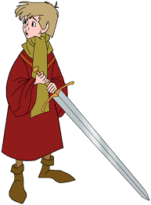
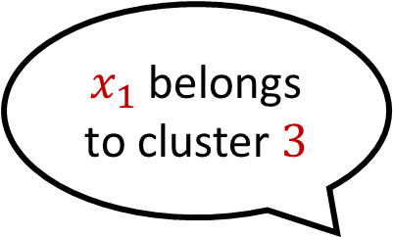
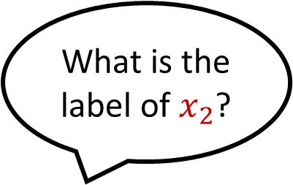


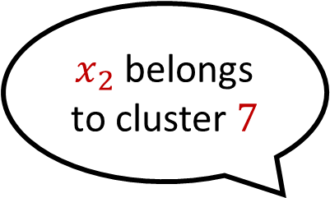
Predictor
Suppose $Π$ outputs noisy labels according to a $(1+α)$approximate clustering $C$ and error rate $λ≤α$
What is the label of $x_{1}$?
$x_{1}$ belongs to cluster $3$
What is the label of $x_{2}$?
$x_{2}$ belongs to cluster $7$

Slide 23
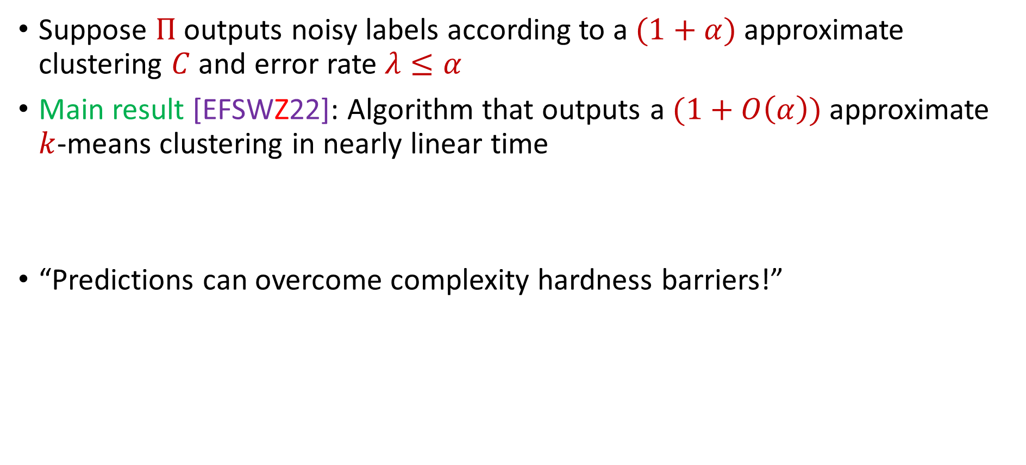
Theoretical Guarantee
Suppose $Π$ outputs noisy labels according to a $(1+α)$approximate clustering $C$ and error rate $λ≤α$
Main result [EFSWZ22]: Algorithm that outputs a $(1+O\left(α\right))$approximate $k$-means clustering in nearly linear time
“Predictions can overcome complexity hardness barriers!”

Slide 24
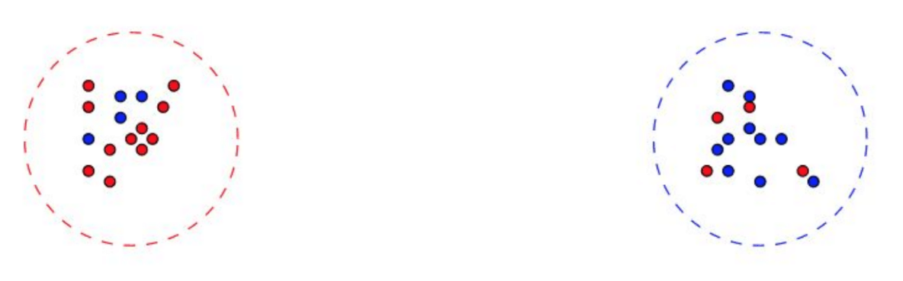

Naïve Approach Does Not Work
Not enough to blindly follow predictions!
Optimal cost $≈0$
Predictor with arbitrary small error has large cost!

Slide 25
Naïve Approach Does Not Work
Can a predictor even help?
Cluster 2
Cluster 1

Slide 26
Naïve Approach Does Not Work
Can a predictor even help?
Cluster 2
Cluster ?
single incorrect label

Slide 27
Naïve Approach Does Not Work
Can a predictor even help?
MUST have assumptions about the accuracy on each cluster
Cluster 2
Cluster ?

Slide 28

Precision and Recall
[EFSWZ22]: Assume cluster sizes are “balanced”
[NCN23]: Let $P_{i}$ be the optimal cluster with label $i$ and $Q_{i}$ be the points that are labeled $i$. Then $\left|Q_{i}∖P_{i}\right|+\left|P_{i}∖Q_{i}\right|≤α⋅|P_{i}|$.
Precision
Recall

Slide 29
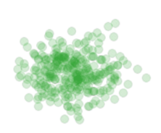

Algorithmic Intuition
Our approach: Closed-form solution for best center of a fixed set of points
$${argmin}_{c} \left[cost(c,P)\right]=\frac{1}{|P|}\sum_{p∈P}{p}$$
$${argmin}_{c}\sum_{p∈P}{{\left\|p−c\right\|}_{2}^{2}}=\frac{1}{|P|}\sum_{p∈P}{p}$$

Slide 30
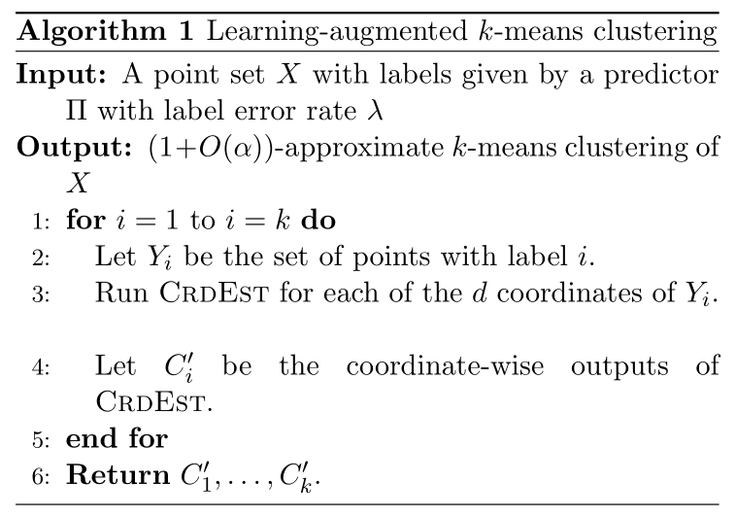
Algorithmic Intuition
Consider each dimension separately

Slide 31
Algorithmic Intuition
Consider each label separately

Slide 32
Algorithmic Intuition
Example:
Cluster 2
Cluster 1
Cluster 3

Slide 33

Algorithmic Intuition
Example: Consider the points with predicted label $1$

Slide 34

Algorithmic Intuition
Example: Consider the points with predicted label $1$
Consider each dimension separately

Slide 35

Algorithmic Intuition
Example: Consider the histogram of points with predicted label $1$

Slide 36

Algorithmic Intuition
Example: Consider the histogram of points with predicted label $1$
Is it true that “pruning” away the outliers removes all incorrect points?

Slide 37
Algorithmic Intuition
Is it true that “pruning” away the outliers removes all incorrect points? NO!

Slide 38

Algorithmic Intuition
Example: Consider the points with label $1$

Slide 39
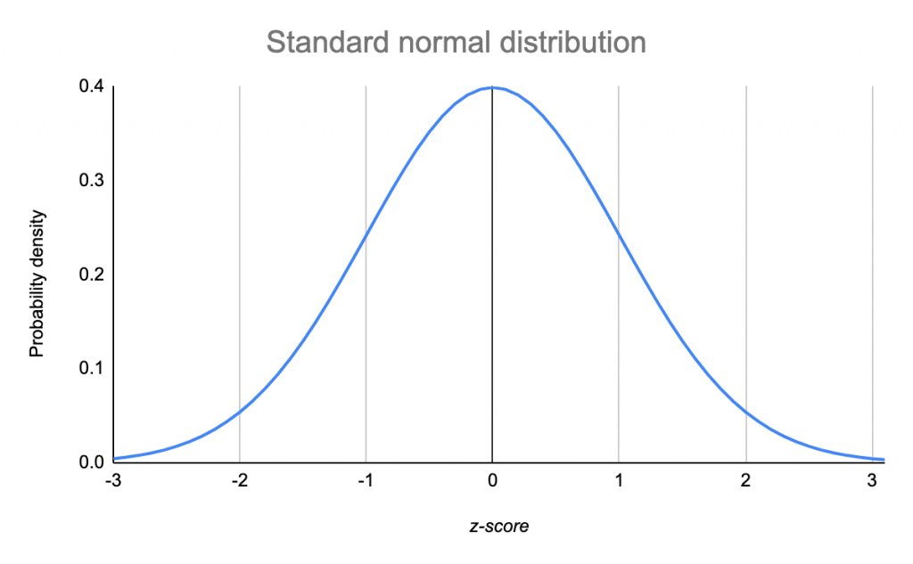
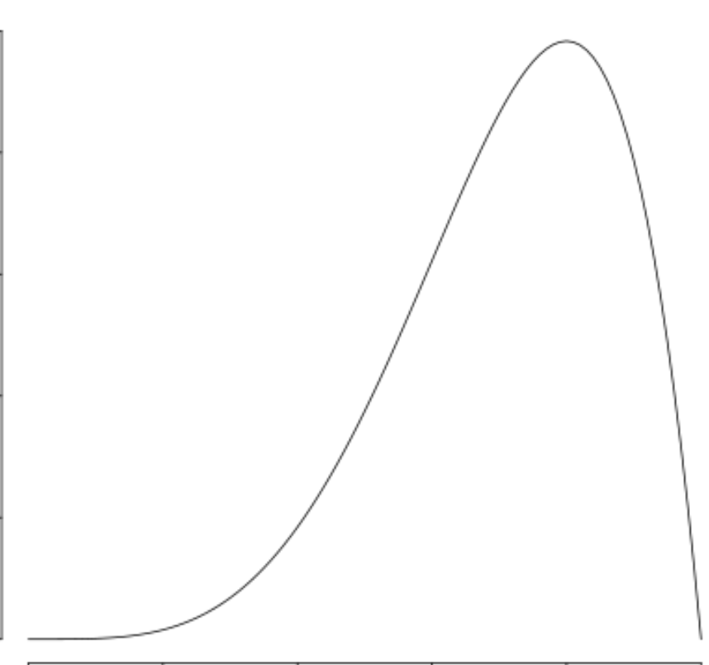



Algorithmic Intuition
Consider each label and each dimension separately
Our approach: Use ideas from robust mean estimation
$$\left(1−α\right)P$$
$$αQ$$

Slide 40

Algorithmic Intuition
Case 1: $Q$ is “far” from $P$
$$\left(1−α\right)P$$
$$αQ$$

Slide 41

Algorithmic Intuition
Case 1: $Q$ is “far” from $P$
Can detect handle this case by “pruning” the distribution
$$\left(1−α\right)P$$
$$αQ$$

Slide 42


Algorithmic Intuition
Case 2: $Q$ is “close” to $P$
$$αQ$$
$$\left(1−α\right)P$$

Slide 43

Algorithmic Intuition
Case 2: $Q$ is “close” to $P$
$Q$ cannot heavily affect the empirical mean $P$
$$αQ$$
$$\left(1−α\right)P$$

Slide 44

Algorithmic Intuition
Algorithm: Find the mean of the shortest interval that contains $\left(1−O(α)\right)$ fraction of the points
$$\left(1−α\right)P$$
$$αQ$$

Slide 45
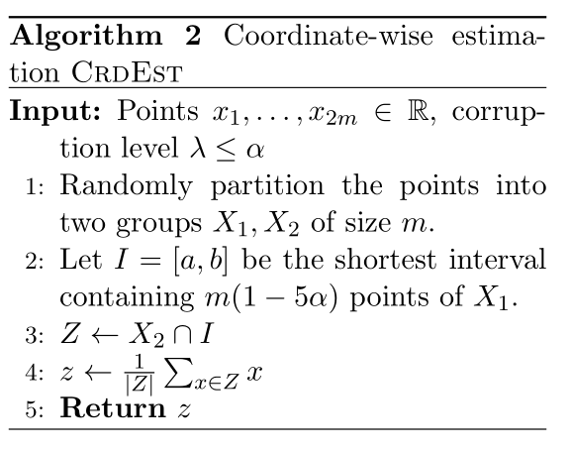
Algorithm
Algorithm: Find the mean of the shortest interval that contains $\left(1−O(α)\right)$ fraction of the points

Slide 46

Analysis Overview
Robust mean estimation gives additive $α$ error to the location of the mean
How does this affect the $k$-means clustering cost?

Slide 47

Analysis Overview
Analysis: Robust mean gives $\left(1+α\right)$-approximation to the $1$-means clustering cost
Recall: Consider each label and each dimension separately
$$\left(1−α\right)P$$
$$αQ$$

Slide 48
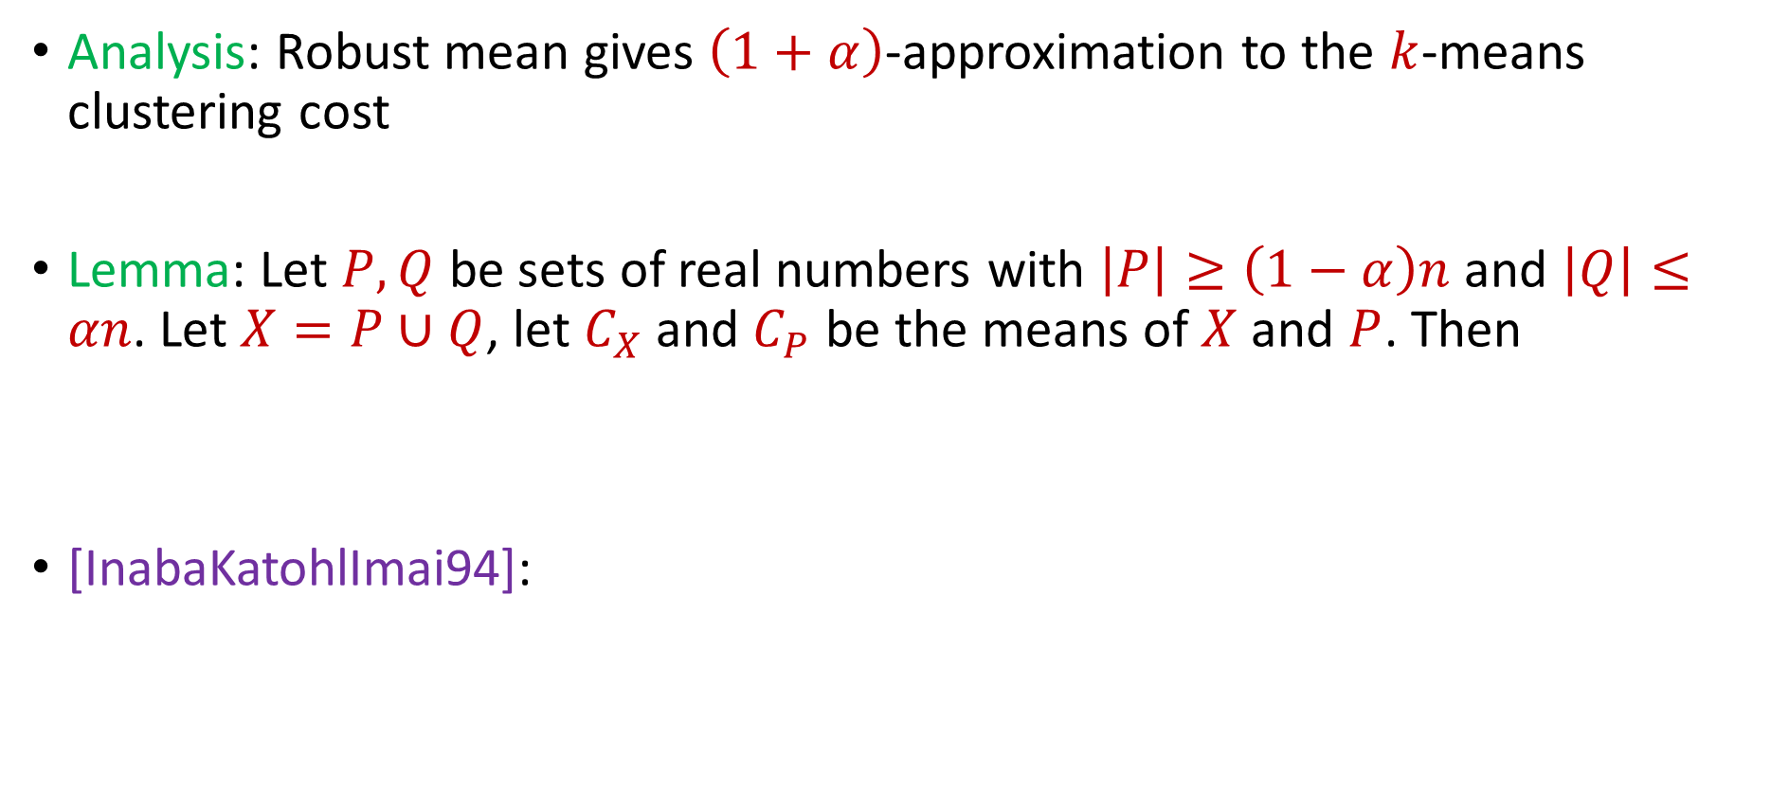
Analysis Overview
Analysis: Robust mean gives $\left(1+α\right)$-approximation to the $k$-means clustering cost
Lemma: Let $P,Q$ be sets of real numbers with $\left|P\right|≥\left(1−α\right)n$ and $\left|Q\right|≤αn$. Let $X=P∪Q$, let $C_{X}$ and $C_{P}$ be the means of $X$ and $P$. Then
[InabaKatohlImai94]:
$$Cost\left(X, C_{P}\right)≤(1+α)Cost(X,C_{X})$$
$$Cost\left(X, C_{P}\right)≤Cost\left(X,C_{X}\right)+\left|X\right|⋅{\left|C_{P}−C_{X}\right|}^{2}$$
Notes:
InabaKatohImai94

Slide 50

Algorithm [NCN23]
“Find the best interval that contains $\left(1−α\right)$ fraction of the points”

Slide 51

Additional Caveats
Assignment of each point to clusters after finding centers in ${\tilde{O}}_{ε,\log{k}}(nd)$ time
Dimensionality reduction to projects to lower-dimension space, use approximate nearest neighbors in lower-dimension space to assign points to clusters

Slide 52

Limitations
Techniques specifically catered to $k$-means clustering (coordinate-wise decomposition, robust mean estimation)
What about $k$-median clustering?

Slide 53

Algorithm [NCN23]
“Sample, prune, and find the geometric median, e.g., [CLMPS16]”

Slide 54
Experimental Results
Case Study: Spectral clustering on graphs varying over time
Dataset: Internet router graph varying over the course of a year
Methodology: Compare to standard benchmarks while using various natural predictors, i.e., noisily perturb true labels and compare to baselines as function of error

Slide 55

Dataset: Internet router graph varying over the course of a year, $k=10$
Conclusion: Our algorithm (using predictor) outperforms benchmarks such as $k$-means ++ for low error while staying competitive with high corruptions

Slide 56

Summary
NP-hard to even approximate within a factor of $1.07$ [Cohen-AddadC.S.20, LeeSchmidtWright17]
Main result [EFSWZ22]: Algorithm that outputs a $(1+O\left(α\right))$approximate $k$-means clustering in nearly linear time
Handles clustering with outliers
Not enough to blindly follow predictions!
Our approach: Use ideas from robust mean estimation

Slide 57


…and Beyond!
Related work:
Semi-supervised active clustering (SSAC) framework: Same cluster queries, [AKB16], [KG17], [MS17], [GHS18], [ABJK18], …, correlation clustering
Future directions:
Spectral clustering? (Talk to me!!)
Other predictors (multiple labels per point), relationship with robust statistics, minimizing the number of queries
Algorithms for $(k,z)$-clustering, i.e., $\sum_{p∈P}{{\min_{c∈C}\left\|p−c\right\|}_{2}^{z}}$
Algorithms for $L_{p}$-metrics, i.e., $\sum_{p∈P}{{\min_{c∈C}\left\|p−c\right\|}_{p}^{p}}$
Notes:
[AshtianiKushagraBen-David16], [KimGhosh17], [MazumdarSaha17], [GamlathHuangSvensson18], [AilonBhattacharyaJaiswalKumar18]

Slide 58


Learning Augmented Algorithms for $k$-Means Clustering
Samson Zhou
Notes:
Talk slower, balanced syllables

